Slide 1




FIRE FIGHTING
ROBOT

Slide 2


GROUP MEMBERS
Sithum
Wathila

Slide 3

INTRODUCTION
Introducing the Fire fighting Robot. An intelligent automated system designed to detect and track flames using multi-directional sensors. Equipped with precise motor control and Arduino-based processing, this robot can navigate toward fire sources while maintaining safe operational parameters

Slide 4

PROJECT GOALS
Develop a robot which can effectively find and resolve fires occuring through an automated system.
Future enhancements which could be used in solving real world fire related issues.

Slide 5
COMPONENTS USED
ARDUINO (MAIN CONTROLLER)
FLAME SENSORS (FRONT, LEFT, AND RIGHT)
MOTOR DRIVER
TWO DC MOTORS
SERVO MOTOR
WATER PUMP
RELAY (TO CONTROL THE PUMP)
BATTERY (BA)
BUCK CONVERTER (VOLTAGE REGULATOR)
SECONDARY BATTERY (BM)

Slide 6
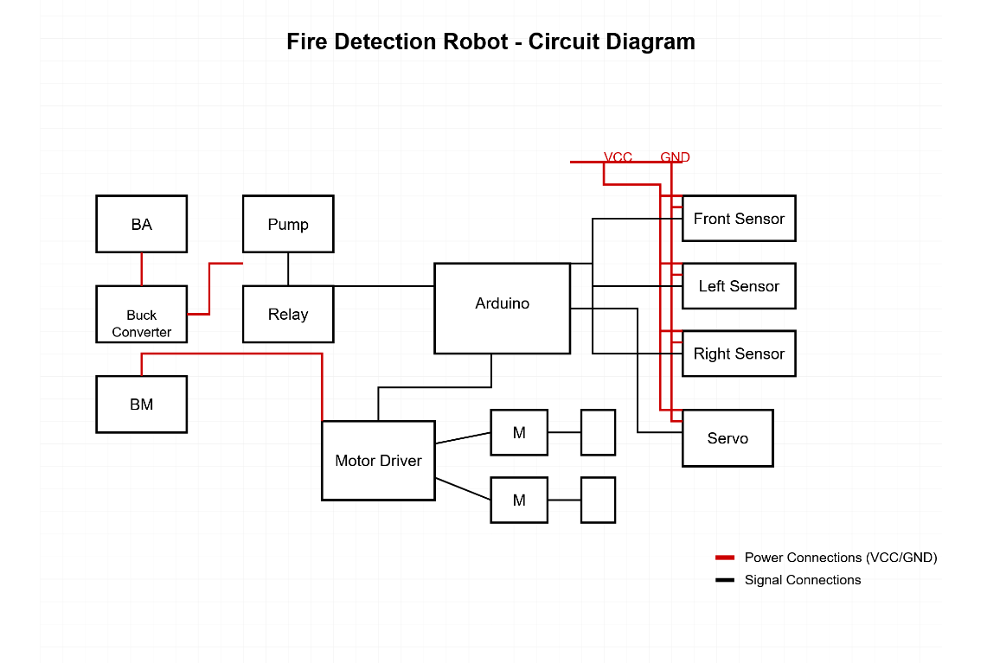
CIRCUIT DIAGRAM

Slide 7
FINAL RESULT OF ROBOT
THE ROBOT SUCCESSFULLY DETECTS FLAMES USING ITS MULTI-DIRECTIONAL SENSOR ARRAY.
Arduino control system effectively processes sensor data and coordinates responses.
Navigation system works but shows inconsistent reliability when changing surfaces or encOUNTERING COMPLEX OBSTACLES.
WATER PUMP FUNCTIONS PROPERLY BUT OCCASIONALLY FAILS TO DEACTIVATE, CONTINUING TO EXPEND WATER UNNECESSARILY.
CORE FUNCTIONALITY REMAINS INTACT DESPITE THESE ISSUES, PROVIDING A FOUNDATION FOR FUTURE IMPROVEMENTS.

Slide 8
CONCLUSION
IN CONCLUSION, THE ROBOT DEMONSTRATES FUNDAMENTAL FIRE DETECTION AND RESPONSE CAPABILITIES DESPITE MINOR RELIABILITY ISSUES. WITH TARGETED IMPROVEMENTS TO THE PUMP CONTROL SYSTEM AND NAVIGATION ALGORITHMS, THIS PROTOTYPE SHOWS PROMISING POTENTIAL FOR REAL-WORLD FIRE DETECTION APPLICATIONS.

Slide 9
THANK YOU

